Slide 1

Excel Hackathon
The United Nation of Retail Services wants to understand the profit of multiple products in
various sectors like enterprises, channel partners, government, mid markets etc.

Slide 2
The United Nation of Retail Services
Total sales from the more than 3.6 million retail establishments in the United States reached about $2.5 trillion in 2012, and retailers supported more than 42 million jobs in the U.S. According to the National Retail Federation, retail industry sales for 2013 are expected to increase 3.4 percent from 2012.

Slide 3
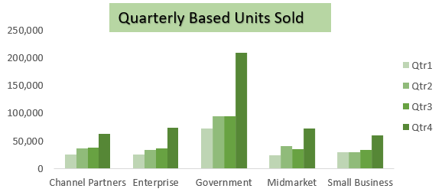
Quarterly based units sold
This data is showing you the quarterly sales of units sold to see on which market, we need to focus more.

Slide 4
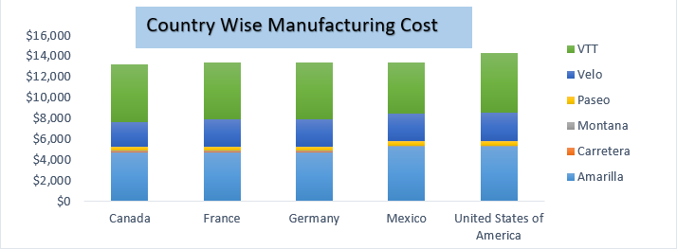
Country wise manufacturing cost
This data represents you country wise manufacturing cost in which you can analyze that all countries are providing all most equal cost of a product to be delivered to an end user

Slide 5
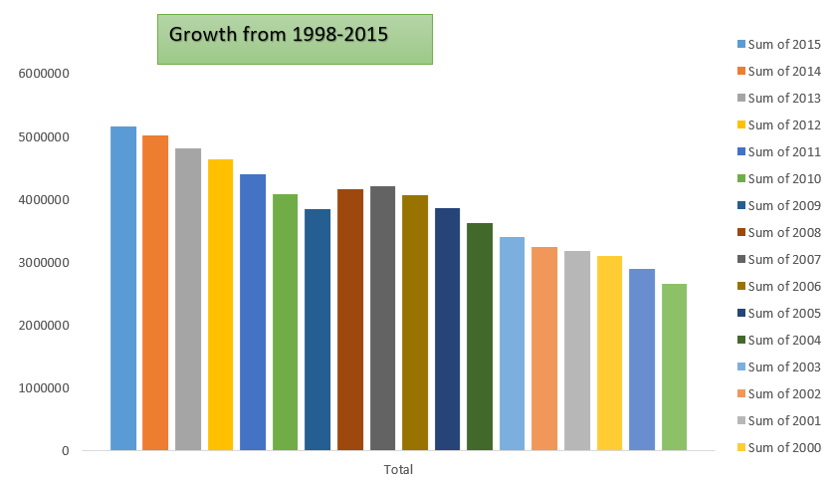
Annually Growth report from 1998-2015
2015
$ 5,161,119
1998
$ 2,662,059
In 1998 when the market was established the annually growth rate was to be this much of the amount
Now If We compare the annual turn over the market has been increased by $ 24,99,060, if we compare with 1998 .

Slide 6
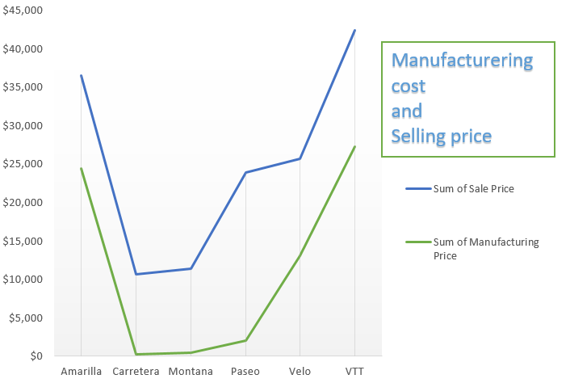
Manufacturering cost and selling price
The measurement of retail sales tracks consumer demand for finished goods by measuring the purchases of durable and non-durable goods over a defined period of time.

Slide 7
If we focus on small market more than our growth rate will increase over upcoming year’s . we need to focus more on advertisement as our 30% percent of our business is coming from E-commerce platform. Ecommerce era is having a huge impact on the brick & mortar stores because of the low inventory cost & wide variety of products for customers to choose from. Luring customers into buying more by ensuring that convenience is given the prime importance by effective rack placement, is sending shivers down the spine of retail giants also. Increased customer retention rate. Reduction in number of fraudulent events. Conversion of customers to buyers by offering best between the web vs store prices. Determined the most trafficked locations to position the products in store. Improved layout within stores based on time series data.
Problem statements

Slide 8
Thanks You

